Slide 1

Footprints
Brett bender, Hailey Halterman, annika traner, joseph williamson

Slide 2
Overall concept
Personality quiz
Pairs user with a destination based on their answers
Users can also “Leave a Footprint” (add cities/locations they’ve been to)
Ability to search for a specific city/Footprint
Annika

Slide 3
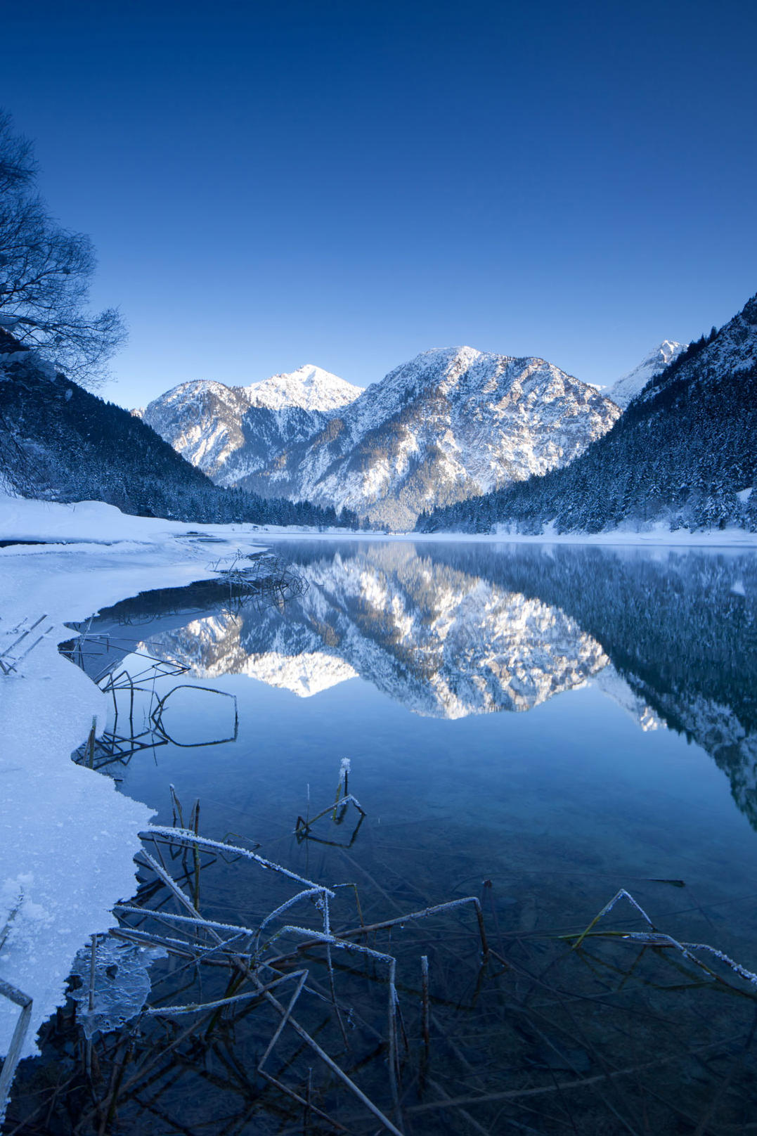
Motivation for development Brett
Want to travel — but not sure where?
Match with a destination suited for you based on personality, budget, duration
Peer-based reviews of vacation destinations

Slide 4
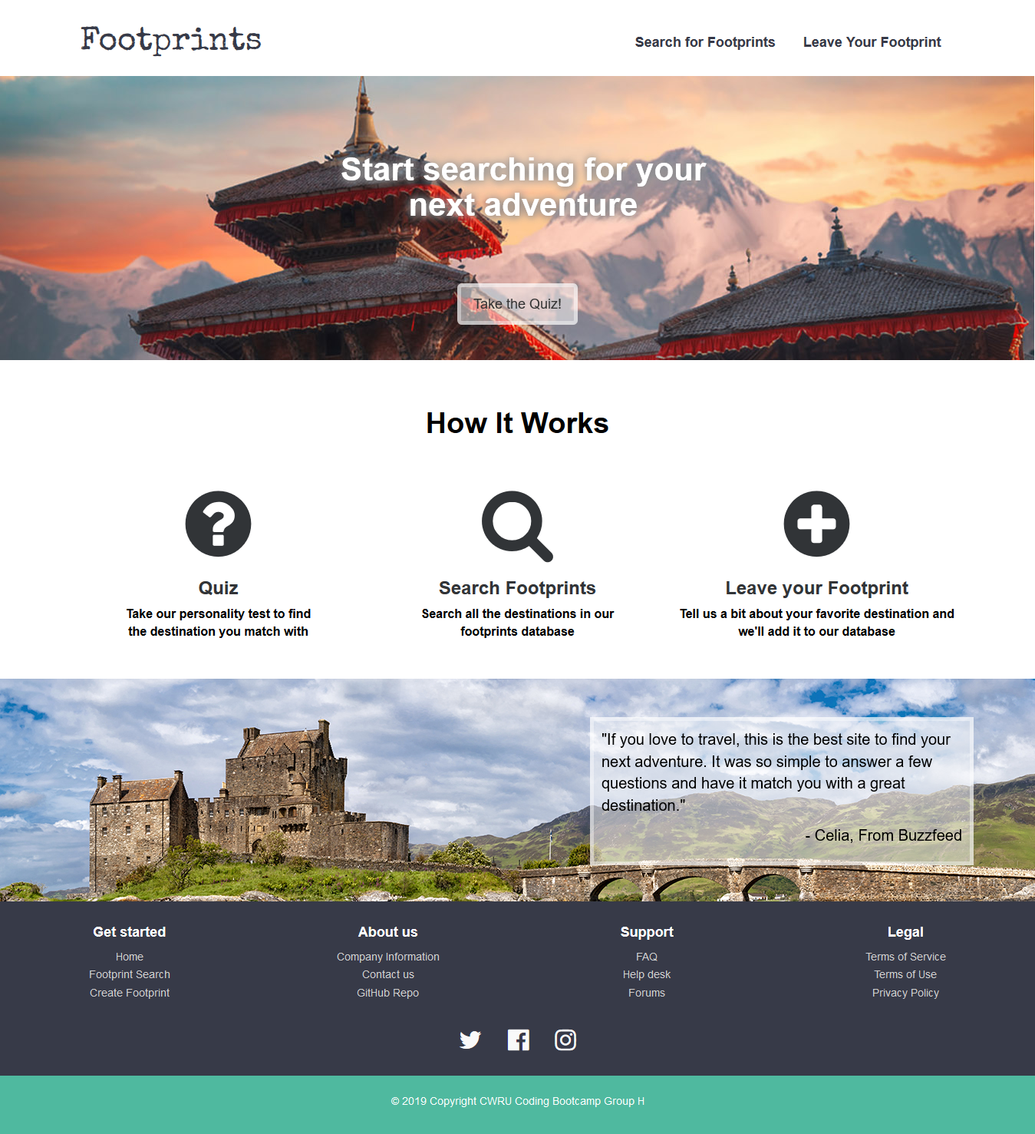
DESIGN PROCESS
Hailey

Slide 5
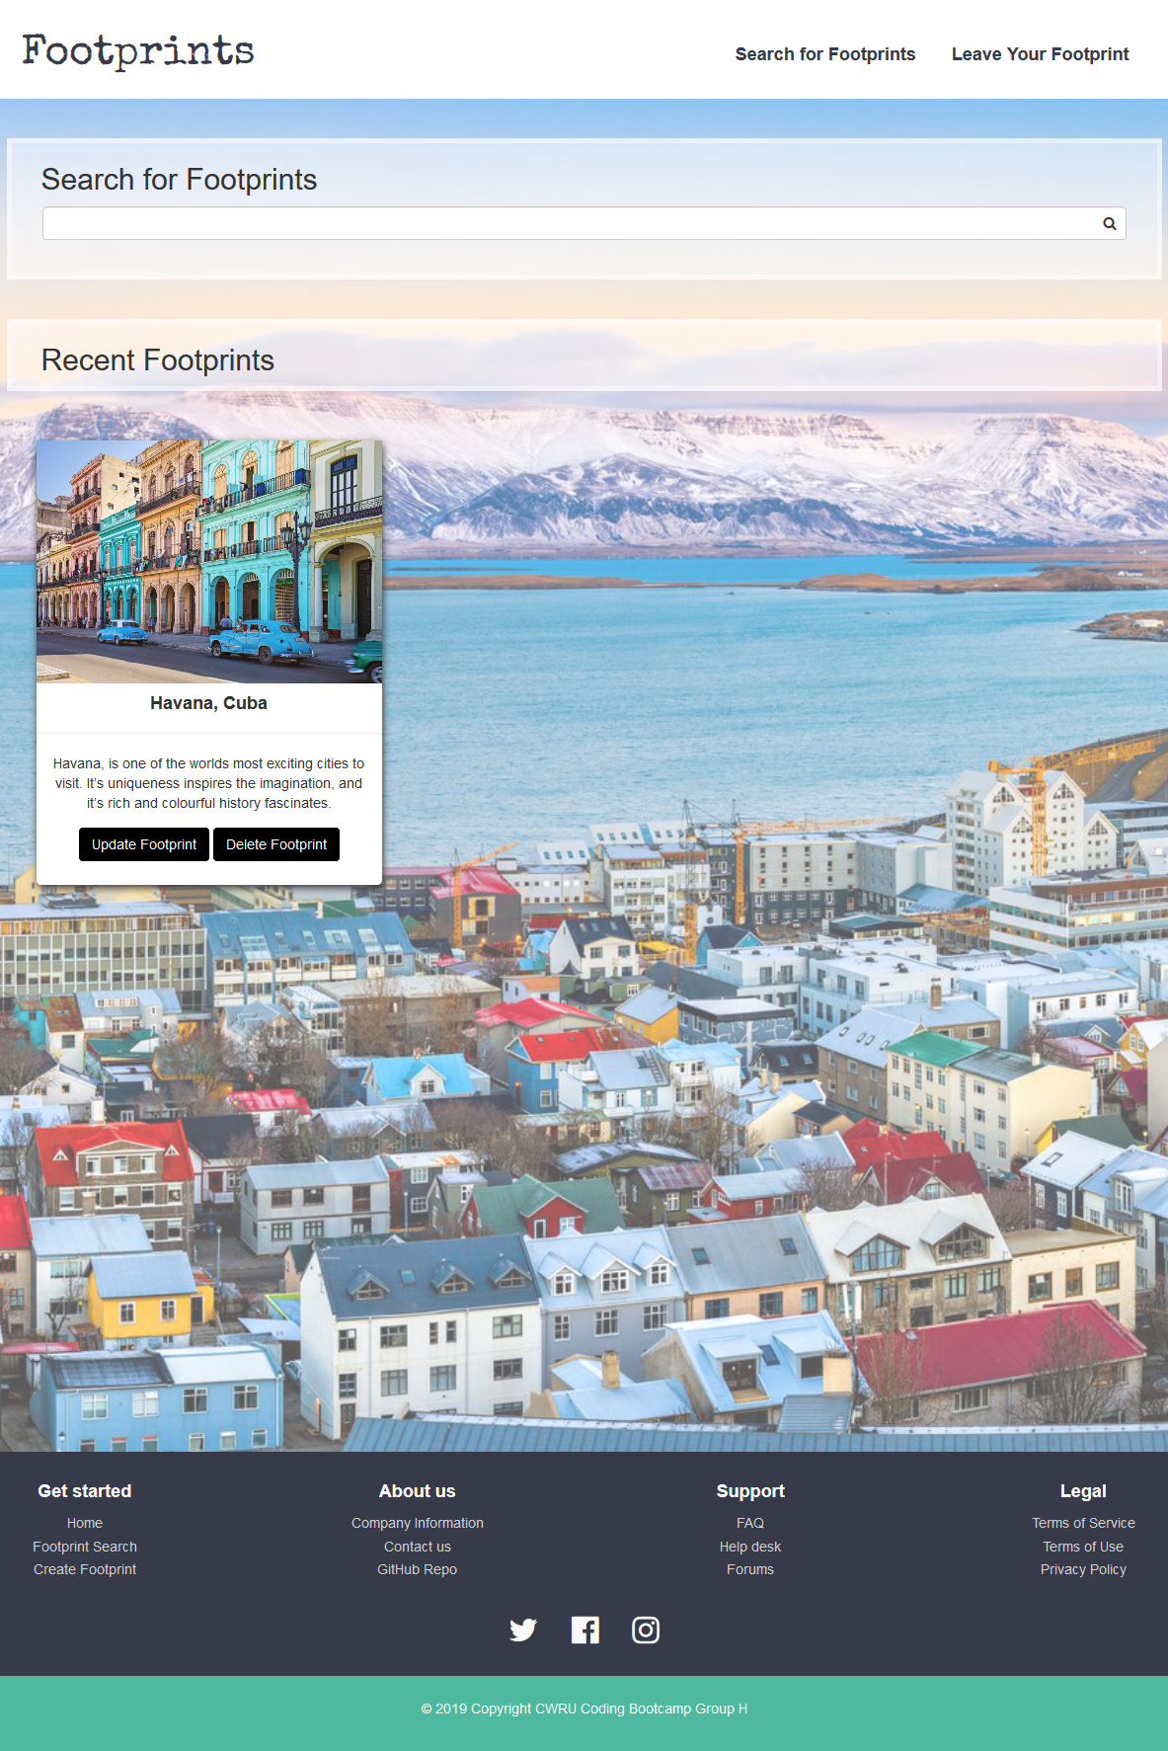
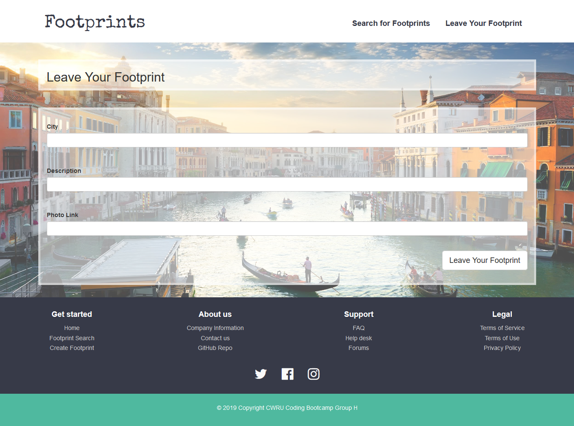

Slide 6
Technologies we used
HTML
CSS
JavaScript
jQuery
MySQL
Travis CI
Heroku
esLint
Postman

Slide 7
DEMO
Joseph

Slide 8
Directions for the future
User Authentication
Logging in with email address, Facebook, etc.
Addition of more locations/Footprints
Adding user’s Footprints to the possible quiz results
Sharing your quiz result on social media

